Slide 1

THULASI LOGU
BCA Student | Web Enthusiast | Creative Learner

Slide 2
I’m Thulasi, currently pursuing my BCA. I’m a passionate and self-motivated learner with a strong interest in exploring new technologies and enhancing my skills. I believe in continuous growth and always strive to improve myself through dedication, hard work, and hands-on learning.
I enjoy working on creative projects, solving problems, and collaborating with others to bring innovative ideas to life. My goal is to build a successful career in [Field/Interest] where I can contribute my knowledge and make a positive impact.
Apart from academics, I love [hobbies or interests, e.g., listening to music, designing, coding, or reading], which help me stay inspired and creative. I believe that staying curious and open to learning is the key to personal and professional success.
ABOUT ME

Slide 3
My Portfolio at a Glance
🌟 About Me – Introduction & career goals
💻 Projects – Hands-on web & app development
🛠️ Skills – Technical expertise & tools
🏆 Achievements – Competitions & mini projects
🎓 Education – Academic background
🎶 Hobbies & Interests – Personal passions
📬 Contact – Ways to connect with me

Slide 4
Project 1 – To-Do App
A simple task manager created using HTML, CSS, and JavaScript.
Features include adding, editing, and deleting tasks in an interactive way.
Key Learning: DOM manipulation and organizing code in small functions.

Slide 5
Project 2 – Student Result Portal
Designed a web application for students to check results using PHP and MySQL.
Technologies Used: HTML, CSS, PHP, MySQL
Future Plans: Adding admin panel, secure login, and graphical result analysis.

Slide 6


SKILLS
HTML5, CSS3, JavaScript
Basics of C, C++, Java, Python
PHP & MySQL basics
Git & GitHub
Notes:
There is Two layers of the background template. 1st one is Transparent and 2nd one is for your background Image. Move the 1st one first and right click to change the Image

Slide 7
Achievements
Participated in inter-college coding
competitions
Created mini projects like portfolio websites
and small web apps
Consistently learning new programming concepts
through practice

Slide 8
EDUCATION
SSLC (2021) – Government Girls Higher Secondary School – 71.4%
HSC (2023) – Government Girls Higher Secondary School – 70.16%
BCA (2025–Present) – SRM Arts and Science College – Currently pursuing (2nd year)

Slide 9
Hobbies & Interests
Exploring web technologies
and design
Listening to music
Spending quality time with
friends and family

Slide 10
Resume Highlight
Strong foundation in programming
Hands-on experience in
web development projects
Interest in full-stack development
Resume available for download

Slide 11
GITHUB LINK
https://thulasil-bca.github.io/nm/

Slide 12
Contact Me
📧 Email: thulasilogu@email.com
📱 Phone: +91 9876543210
🔗 LinkedIn: linkedin.com/in/thulasilogu
Closing Note: Excited to grow, learn, and contribute in the tech world.

Slide 13
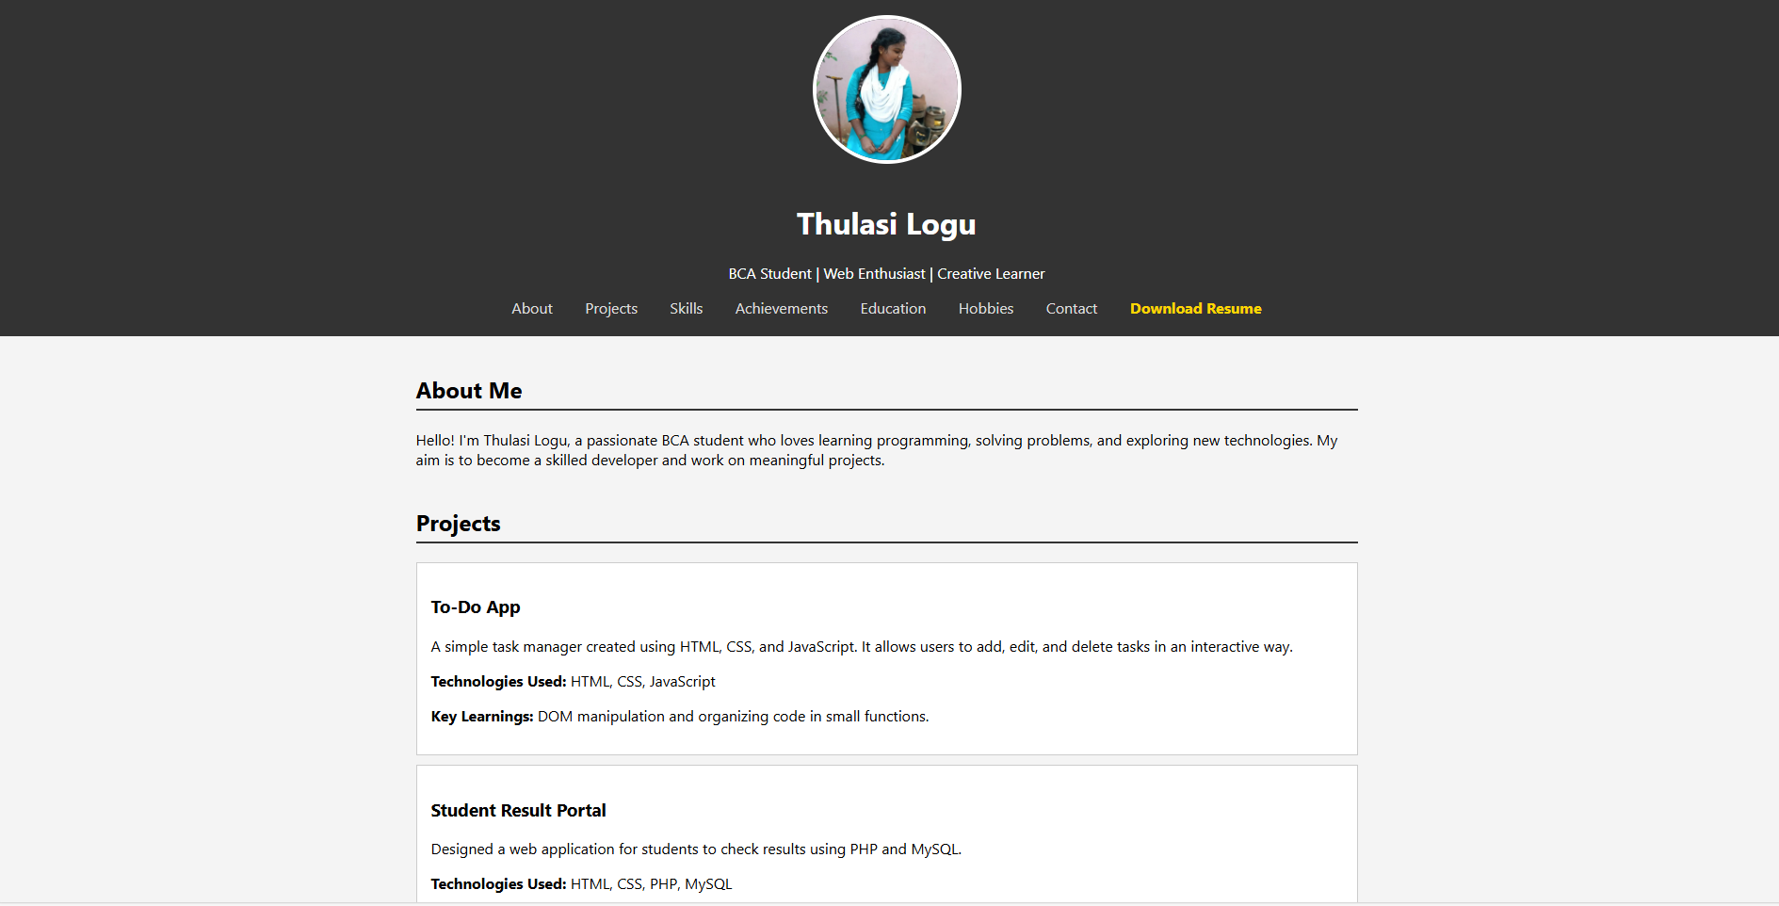
PORTFOLIO

Slide 14
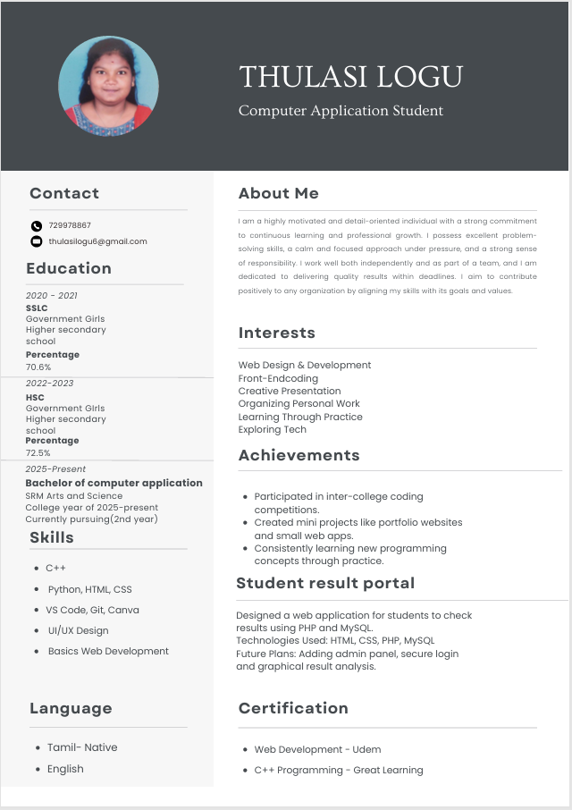
RESUME

Slide 15




About portfolio
This portfolio showcases my journey as a BCA student, highlighting my projects, skills, achievements, and academic path.
It reflects my passion for technology, continuous learning, and dedication to becoming a skilled developer.
Thank You! ✨

